Slide 1
FLEXIBLE GROUP MANAGEMENT WITH ANONYMOUS DECISION MAKING
Supervisors
Kirill Nikitin
Enis Ceyhun Alp
Advisor
Prof. Bryan Alexander Ford
Muhammad Faisal

Slide 2
Need for groups formation
Large communities have various interests and concerns.

Slide 3
Need for groups formation
Large communities have various interests and concerns.
Community members, with same interests, tend to get closer:

Slide 4
Need for groups formation
Large communities have various interests and concerns.
Community members, with same interests, tend to get closer:
  Organize beneficial activities.

Slide 5
Need for groups formation
Large communities have various interests and concerns.
Community members, with same interests, tend to get closer:
  Organize beneficial activities.
  Enlarge their circle by attracting other community members.

Slide 6
Need for groups formation
Large communities have various interests and concerns.
Community members, with same interests, tend to get closer:
  Organize beneficial activities.
  Enlarge their circle by attracting other community members.
Community members form groups such as:

Slide 7
Need for groups formation
Large communities have various interests and concerns.
Community members, with same interests, tend to get closer:
  Organize beneficial activities.
  Enlarge their circle by attracting other community members.
Community members form groups such as:
  Political parties.

Slide 8
Need for groups formation
Large communities have various interests and concerns.
Community members, with same interests, tend to get closer:
  Organize beneficial activities.
  Enlarge their circle by attracting other community members.
Community members form groups such as:
  Political parties.
  NGOs promoting environment sustainability.

Slide 9
Need for groups formation
Large communities have various interests and concerns.
Community members, with same interests, tend to get closer:
  Organize beneficial activities.
  Enlarge their circle by attracting other community members.
Community members form groups such as:
  Political parties.
  NGOs promoting environment sustainability.
  Start up.

Slide 10
Need for groups formation
Large communities have various interests and concerns.
Community members, with same interests, tend to get closer:
  Organize beneficial activities.
  Enlarge their circle by attracting other community members.
Community members form groups such as:
  Political parties.
  NGOs promoting environment sustainability.
  Start up.
  …

Slide 11
Various group activities
A group may want to do various activities

Slide 12
Various group activities
A group may want to do various activities
  Simple: organizing social gatherings and events.

Slide 13
Various group activities
A group may want to do various activities
  Simple: organizing social gatherings and events.
  Or deciding on new membership requirements.

Slide 14
Various group activities
A group may want to do various activities
  Simple: organizing social gatherings and events.
  Or deciding on new membership requirements.
  Much much complex: managing financial assets and resources.

Slide 15
Various group activities
A group may want to do various activities
  Simple: organizing social gatherings and events.
  Or deciding on new membership requirements.
  Much much complex: managing financial assets and resources.
    Buying or selling necessary tools.

Slide 16
How to manage these activities?
All group members meet physically or virtually.

Slide 17
How to manage these activities?
All group members meet physically or virtually.
  Not all members will be free then.

Slide 18
How to manage these activities?
All group members meet physically or virtually.
  Not all members will be free then.
  Not all members are interested in every discussion.

Slide 19
How to manage these activities?
All group members meet physically or virtually.
  Not all members will be free then.
  Not all members are interested in every discussion.
  Practically, hard to run a discussion in large groups.

Slide 20
How to manage these activities?
Divide group activities into different categories .

Slide 21
How to manage these activities?
Divide group activities into different categories .
Assign each category to a subset of the group members.

Slide 22
How to manage these activities?
Divide group activities into different categories .
Assign each category to a subset of the group members.
  Gatherings : members with logistics experience.

Slide 23
How to manage these activities?
Divide group activities into different categories .
Assign each category to a subset of the group members.
  Gatherings : members with logistics experience.
  Membership requirements: interviews and HR experience

Slide 24
How to manage these activities?
Divide group activities into different categories .
Assign each category to a subset of the group members.
  Gatherings : members with logistics experience.
  Membership requirements: interviews and HR experience
  Financials : finance experience.

Slide 25
Group management scheme goals
Separation of roles to ensure practicality. ✅

Slide 26
Group management scheme goals
Separation of roles to ensure practicality. ✅
Ability to evolve groups through membership management. ✅

Slide 27
Flexibility
Group goals evolve

Slide 28
Flexibility
Group goals evolve
  With time.

Slide 29
Flexibility
Group goals evolve
  With time.
  More diverse members.

Slide 30
Flexibility
Group goals evolve
  With time.
  More diverse members.
Rules may change with goals:

Slide 31
Flexibility
Group goals evolve
  With time.
  More diverse members.
Rules may change with goals:
  Can be added or removed.
  Current rules can be edited.

Slide 32
Group management scheme goals
Separation of roles to ensure practicality. ✅
Ability to evolve groups through membership management. ✅
Flexibility to change group rules and managing members in each role. ✅

Slide 33
Anonymous decision taking
Decision taking can be sensitive:

Slide 34
Anonymous decision taking
Decision taking can be sensitive:
  Removing members.

Slide 35
Anonymous decision taking
Decision taking can be sensitive:
  Removing members.
  Prioritize some activities with money.

Slide 36
Anonymous decision taking
Decision taking can be sensitive:
  Removing members.
  Prioritize some activities with money.
Malicious members can try:

Slide 37
Anonymous decision taking
Decision taking can be sensitive:
  Removing members.
  Prioritize some activities with money.
Malicious members can try:
  Buy others’ support.

Slide 38
Anonymous decision taking
Decision taking can be sensitive:
  Removing members.
  Prioritize some activities with money.
Malicious members can try:
  Buy others’ support.
  Coercion.

Slide 39
Anonymous decision taking
Decision taking can be sensitive:
  Removing members.
  Prioritize some activities with money.
Malicious members can try:
  Buy others’ support.
  Coercion.
Decisions should be anonymous.

Slide 40
Group management scheme goals
Separation of roles to ensure practicality. ✅
Ability to evolve groups through membership management. ✅
Flexibility to change group rules and managing members in each role. ✅
Ensure anonymous decision taking within each role. ✅

Slide 41
Group structure
Role

Slide 42
Group structure
Role
  Subset of the group members.

Slide 43
Group structure
Role
  Subset of the group members.
  member can belong to more than one role.

Slide 44
Group structure
Role
  Subset of the group members.
  Members can belong to more than one role.
  i.e. admins and super admins ..

Slide 45
Group structure Example
Roles
Members
Finance experts
logistics experts
Alice
Bob
Carol
Alice
Alice
Bob

Slide 46
Group structure
Requests

Slide 47
Group structure
Requests
  To do a predefined activity.

Slide 48
Group structure
Requests
  To do a predefined activity.
  To define a new activity.

Slide 49
Group structure
Requests
  To do a predefined activity.
  To define a new activity.
  Such as
    Change membership of a member in a role.

Slide 50
Group structure
Requests
  To do a predefined activity.
  To define a new activity.
  Such as
    Change membership of a member in a role.
    Call for social gathering.

Slide 51
Group structure Example
Roles
Members
Finance experts
logistics experts
Alice
Bob
Carol
Alice
Alice
Bob
Requests
Organize gathering
Adding member
Conditions
Procedures
Conditions
Procedures

Slide 52
Group structure
Authorizations
  Defines which roles approve which types of requests.

Slide 53
Group structure
Authorizations
  Defines which roles approve which types of requests.
  Request is approved when approved from at least half of its roles’ members.

Slide 54
Group structure
Authorizations
  Defines which roles approve which types of requests.
  Request is approved when approved from at least half of its roles’ members.
  For example, to allow super admins to change members in admins.

Slide 55
Group structure Example
Roles
Members
Finance experts
logistics experts
Alice
Bob
Carol
Alice
Alice
Bob
Requests
Organize gathering
Adding member
Conditions
Procedures
Conditions
Procedures
Authorizations
Organize gathering
Adding member
logistics experts
Members
Members

Slide 56
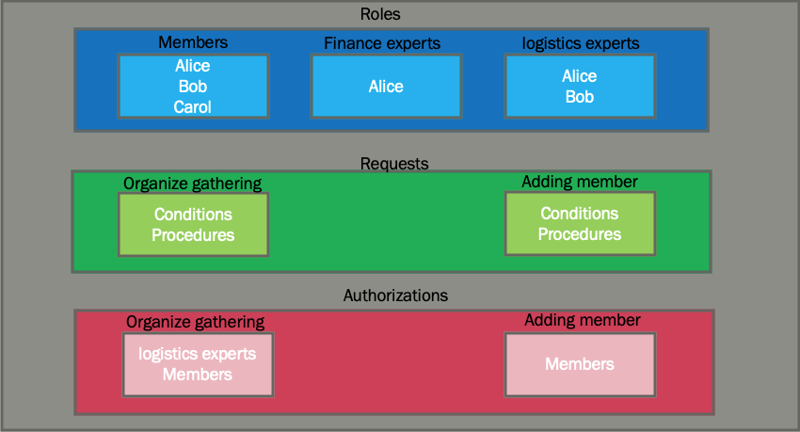
Overall structure
Member side
Prover
Database
Create messages for requests and responses
stores all messages with correct timestamp
Verifier
Decide current state

Slide 57
Conclusion
Introduced system core for managing groups.
Flexible in changing rules and members.
Can protect against peer pressure and support buying.
Can be extended to use blockchain.

